Slide 1
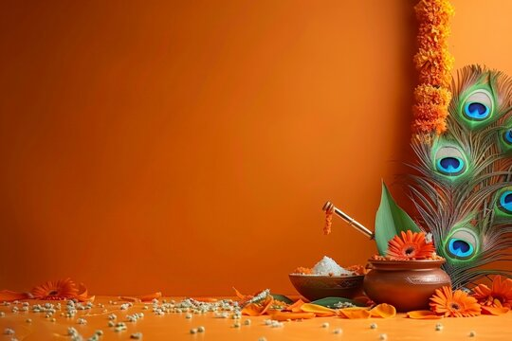
Happy Janmashtami!
May Lord Krishna's divine flute fill your life with sweet music, boundless joy, and lasting peace.
Radhe Radhe….

